Slide 1

Chapter Three
Requirements Elicitation

Slide 2
Topics to be covered
Requirements sources Elicitation techniques N.B. Requirements elicitation concept & processes are already covered in chapter two.

Slide 3
Requirements elicitation
The heart of requirements development is elicitation, the process of identifying the needs and constraints of the various stakeholders for a software system.
Elicitation is a collaborative and analytical process that includes activities to collect, discover, extract, and define requirements.

Slide 4
Cont’d…
Elicitation is used to discover business, user, functional, and nonfunctional requirements, along with other types of information.
Req. elicitation is perhaps the most challenging, critical, error-prone, and communication-intensive aspect of software development.

Slide 5
Components of requirements elicitation
Application domain understanding
Problem understanding
Business understanding
Understanding the needs and constraints of system stakeholders

Slide 6
Elicitation activities
Application domain understanding
  Application domain knowledge is knowledge of the general area where the system is applied.
Problem understanding
  The details of the specific customer problem where the system will be applied must be understood.
Business understanding
  You must understand how systems interact and contribute to overall business goals.
Understanding the needs and constraints of system stakeholders
  You must understand, in detail, the specific needs of people who require system support in their work.

Slide 7
Elicitation stages
Objective setting
  The organisational objectives should be established including general goals of the business, an outline description of the problem to be solved, why the system is necessary and the constraints on the system.
Background knowledge acquisition
  Background information about the system includes information about the organisation where the system is to be installed, the application domain of the system and information about existing systems.
Knowledge organisation
  The large amount of knowledge which has been collected in the previous stage must be organised and collated.
Stakeholder requirements collection
  System stakeholders are consulted to discover their requirements.

Slide 8
Elicitation techniques
Specific techniques which may be used to collect knowledge about system requirements. But this knowledge must be structured
  Partitioning – combining related knowledge
  Abstraction - recognising generalities
  Projection - organising according to perspective
Elicitation problems
  Not enough time for elicitation
  Inadequate preparation by engineers
  Stakeholders are unconvinced of the need for a new system

Slide 9
  Elicitation techniques
Scenarios
Interviews
  Open ended
  Close ended
Observations and social analysis
Requirements reuse
Prototype
Workshop
Focus group discussions etc.

Slide 10
Scenario
Scenarios are examples of interaction sessions which describe how a user interacts with a system.
Scenarios are stories which explain how a system might be used. They should include
  a description of the system state before entering the scenario
  the normal flow of events in the scenario
  exceptions to the normal flow of events
  information about concurrent activities
  a description of the system state at the end of the scenario

Slide 11
Scenario example
Log in to system
Issue order document command
Enter reference number of the required document
Select a delivery option
Log out from system
Let’s change this scenario in to illustrated diagram.

Slide 12
Scenario example

Slide 13
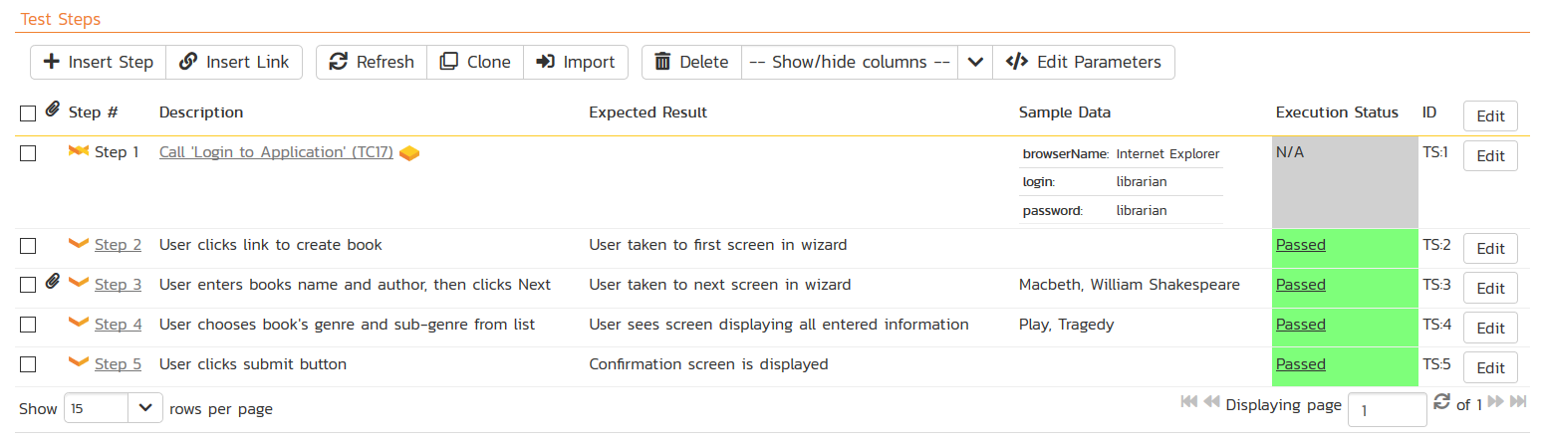
Scenario example

Slide 14
Requirements reuse
Reuse involves taking the requirements which have been developed for one system and using them in a different system.
Requirements reuse saves time and effort as reused requirements have already been analysed and validated in other systems.
Currently, requirements reuse is an informal process but more systematic reuse could lead to larger cost savings.

Slide 15
Reuse possibilities
Where the requirement is concerned with providing application domain information.
Where the requirement is concerned with the style of information presentation. Reuse leads to a consistency of style across applications.
Where the requirement reflects company policies such as security policies.

Slide 16
  Requirements sources
Goals
The term “goal” (sometimes called “business concern” or “critical success factor”) refers to the overall, high-level objectives of the software.
Domain knowledge
The software engineer needs to acquire or have available knowledge about the application domain.
Stakeholders
Identify, represent, and manage the “viewpoints” of many different types of stakeholders.

Slide 17
Cont’d…
Business rules
These are statements that define or constrain some aspect of the structure or the behavior of the business itself.
Organizational environment
Software is often required to support a business process, the selection of which may be conditioned by the structure, culture, and internal politics of the organization.
Operational environment
Requirements will be derived from the environment in which the software will be executed

Slide 18
Reading Assignment
Chapter III: Requirements Elicitation | Sommerville - 2011 | Wiegers – 2003
3.1. Requirements Sources | Chapter 4 – section 5 | Chapter 5, 6 & 9
3.2. Elicitation Techniques

Slide 19
END OF CHAPTER THREE

